Slide 1
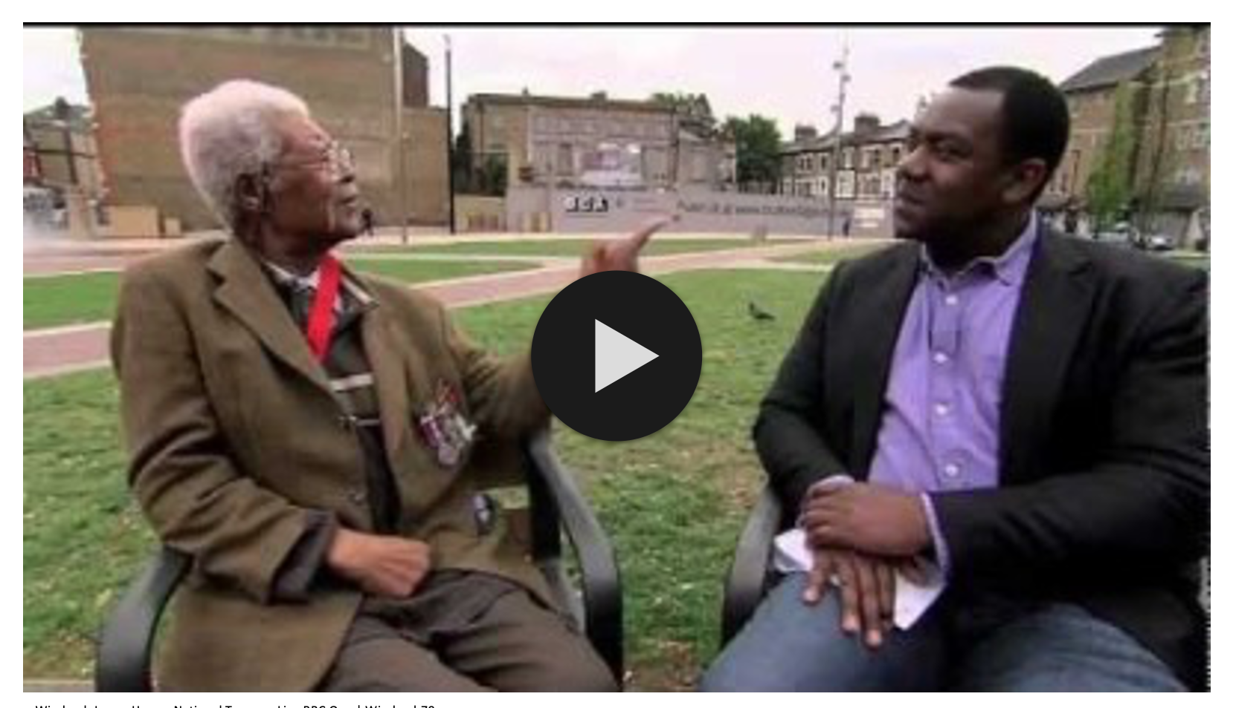
The Windrush Generation KS2
Embedded video - to enable you to play the video please make sure you are connected to the internet, click 'enable content' at the top right of the document,
then click the play button in the middle of the video window.
Share your activities - we would love to share on our social media what you have made, your thoughts of Luton Carnival and any messages to our Windrush Generation in Luton.
Please share images, videos and comments via fiona@carnivalarts.org,uk

Slide 2
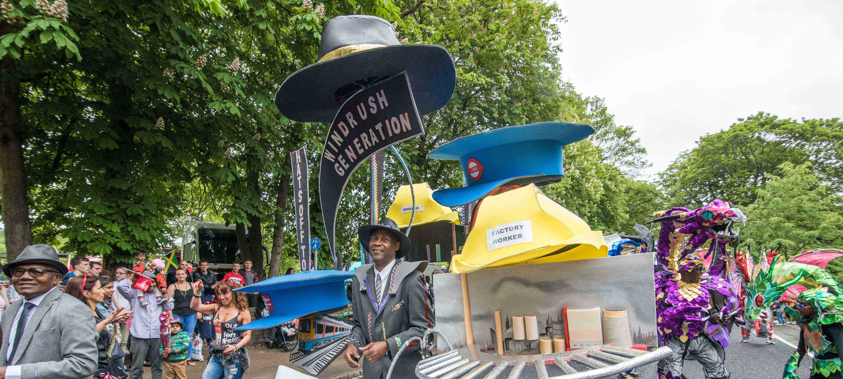
The Windrush Generation

Slide 3
The Windrush Generation
Windrush Lenny Henry -National Treasures Live BBC One | Windrush70
windrushfoundation.com

Slide 4
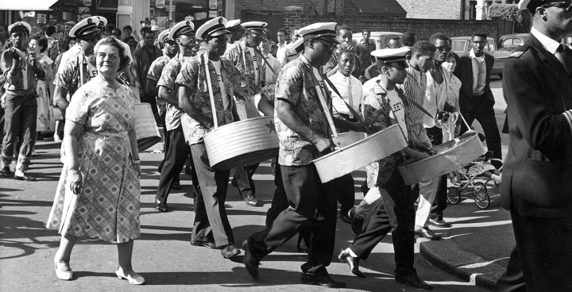
The Windrush Generation
The migration of Caribbean workers helped to make Britain a multicultural and a multiracial society. New languages, fashions, foods and ideas were introduced.
windrushfoundation.com

Slide 5
The Windrush Generation
Caribbean communities were already very diverse - and brought with them musical influences from Latin America, Africa and Asia, all
having a significant impact musically on the UK. Many musicians come with jazz, blues, gospel music, and Latin music when the UK music scene was primarily swing-based and dance bands.
Many of the styles you listen to today have roots in the fusion of
Jamaican reggae and British music, developing genres such as drum and bass and dubstep.
Artist Lord Shawty coined ‘soca’ (Soul of Calypso) to revive traditional Trinidadian and Tobagan calypso music in the 1970’s. By the 1980s, soca had evolved into a range of styles, and it was popular in Britain to sample calypso and other Caribbean beats and rhythms into tracks. This sampling style continued to inspire artists in the years to come and lay the foundations for many electronic styles such as dancehall, UK garage, jungle, ragga and hip hop.
In the early 2000s, London grime artists such as Dizzee Rascal, Stormzy and Lethal Bizzle encompassed many of these styles and revolutionised the British rap scene.
windrushfoundation.com

Slide 6
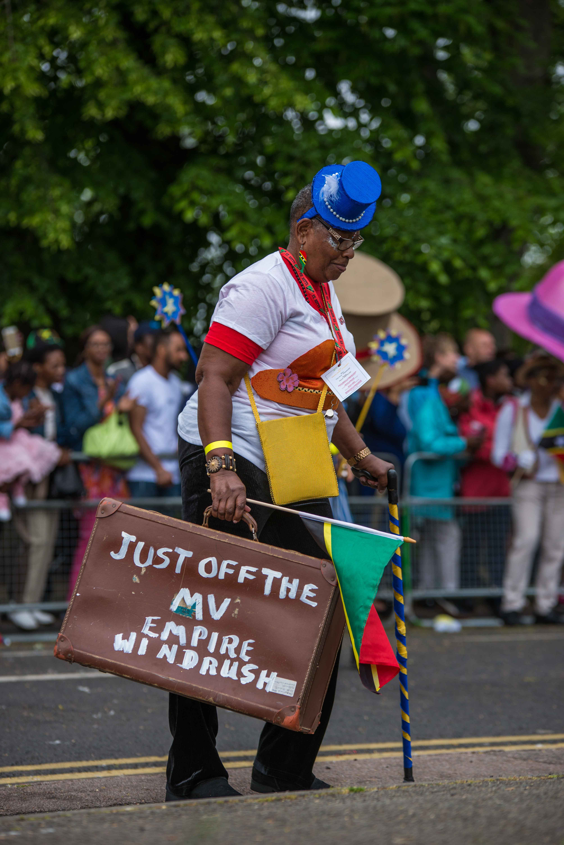
Luton Carnival Roots
One of the greatest things that the Caribbean workers brought with them was Carnival. Luton has hosted parades since the 1400s, but in 1976 the Windrush Generation introduced the Caribbean carnival flavour to Luton. The longest running Caribbean carnival groups in Luton is St Kitts, Nevis & Friends Carnival Group (SKNAF).
In 1984, the George Richards and other friends from St Kitts and Nevis came together to form St Kitts, Nevis and Friends Association (SKNAF). Activities of the Association grew into its involvement with the Luton International Carnival.
​
The group has been led for many years by Mrs Margaret Matthew (Auntie Margaret), here is a picture of Auntie Margaret at Luton International Carnival in 2019 with her Windrush suitcase.
St Kitts, Nevis and Friends carnival group continues to be an active participant in the Luton International Carnival.
St Kitts, Nevis & Friends Carnival Group, Luton International Carnival 2019

Slide 7
Luton Carnival Roots
Revellers Steelband took inspiration from the Empire Windrush ship to play a medley for Luton International Carnival judges in 2016. Their theme 'Luton is the Place for me’ about migration to Luton from the Caribbean and beyond.
Revellers Steelband classic calypso medley for Luton Carnival judges 2016 | Revellers Steelband
St Kitts, Nevis & Friends Carnival Group, Luton International Carnival 2019

Slide 8
Luton Carnival Roots
Here is footage of Luton Independence Day Parade in 1964. Watch out for the Steelpan Band at the end, this might be the first glimpse of the Caribbean influence in Luton.
Luton Independence Day Parade, 1964 | Emerton321
St Kitts, Nevis & Friends Carnival Group, Luton International Carnival 2019

Slide 9
Luton Carnival Roots
Luton International Carnival has grown into the biggest one day carnival in the UK.
Luton International Carnival | Copperwheat Films
St Kitts, Nevis & Friends Carnival Group, Luton International Carnival 2019

Slide 10
Luton Carnival Roots
What has changed about parades in Luton since 1964?
What has stayed the same?
How important to Luton are the cultural influences brought by the Windrush Generation?
St Kitts, Nevis & Friends Carnival Group, Luton International Carnival 2019

Slide 11
Carnival Costume Activity
How to make a Windrush headdress Mahogany Carnival Arts
https://www.mahoganycarnival.com/how-to-make-a-windrush-hat/
How to make a steelpan headdress with UKCCA
https://www.carnivalarts.org.uk/post/how-to-make-a-steel-pan-carnival-head-piece
We would love to share on our social media what you have made, your thoughts of Luton Carnival and any messages to our Windrush Generation in Luton.
Please share images, videos and comments via fiona@carnivalarts.org,uk

