Slide 1
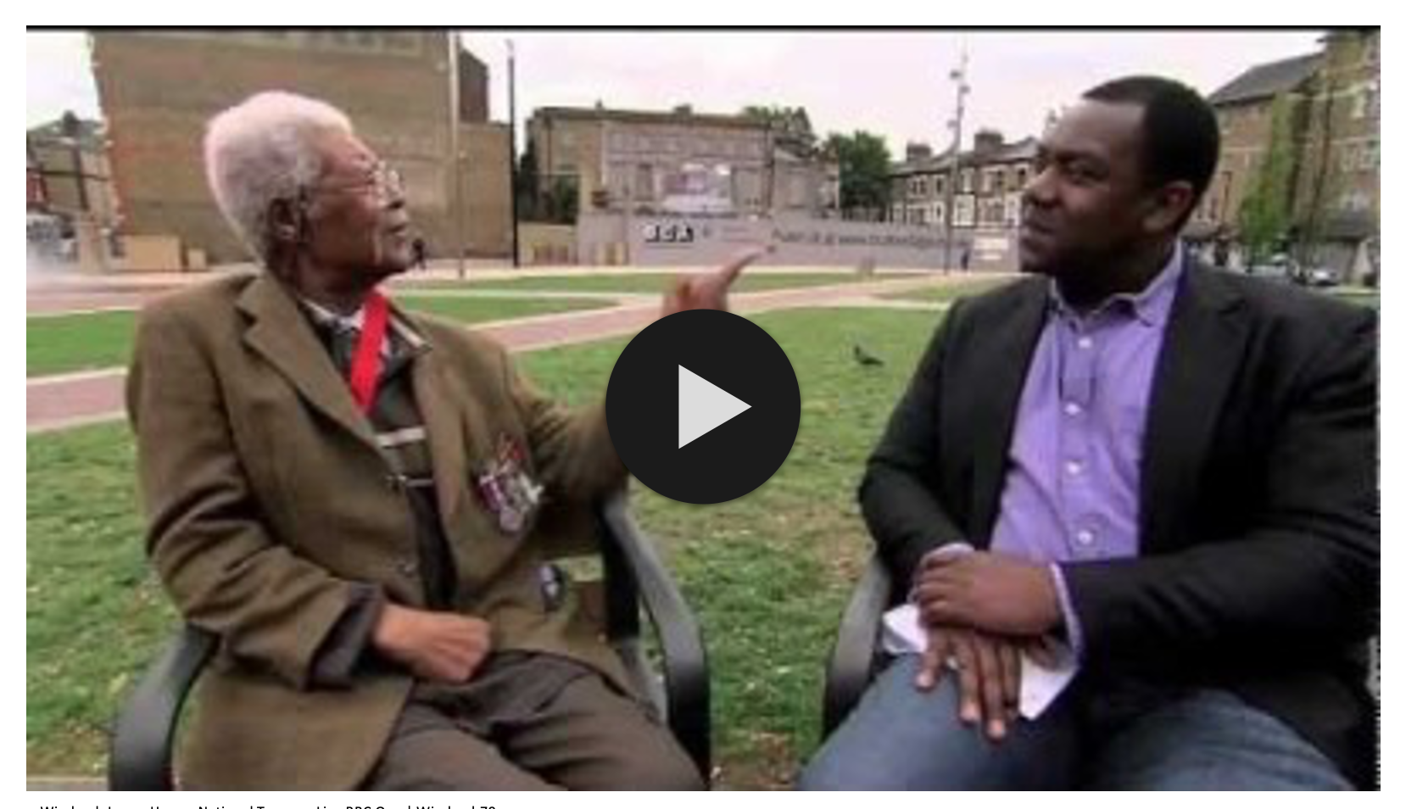
The Windrush Generation KS1
Embedded video - to enable you to play the video please make sure you are connected to the internet, click 'enable content' at the top right of the document,
then click the play button in the middle of the video window.
Options – there is a video option or written explanation to the background of the Windrush story.
Share your activities - we would love to share on our social media what you have made, your thoughts of Luton Carnival and any messages to our Windrush Generation in Luton.
Please share images, videos and comments via fiona@carnivalarts.org,uk

Slide 2
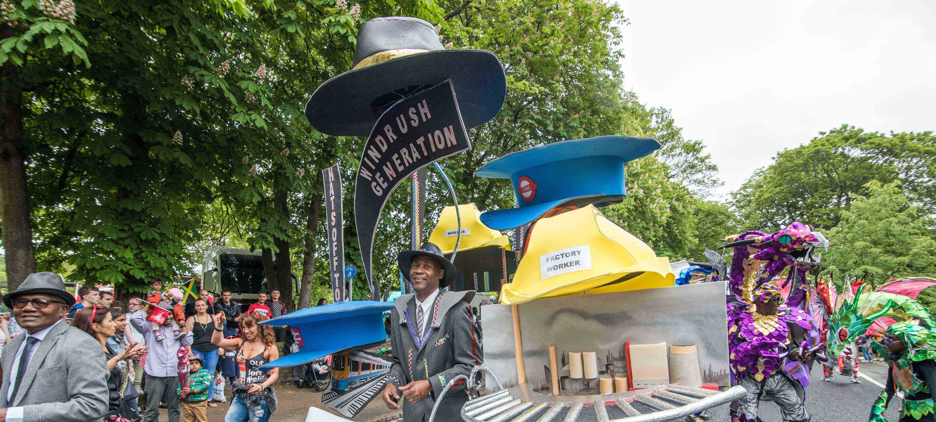
The Windrush Generation

Slide 3
The Windrush Generation
What is the Windrush Generation? | Finding My Family: A Windrush Special | Newsround
windrushfoundation.com

Slide 4
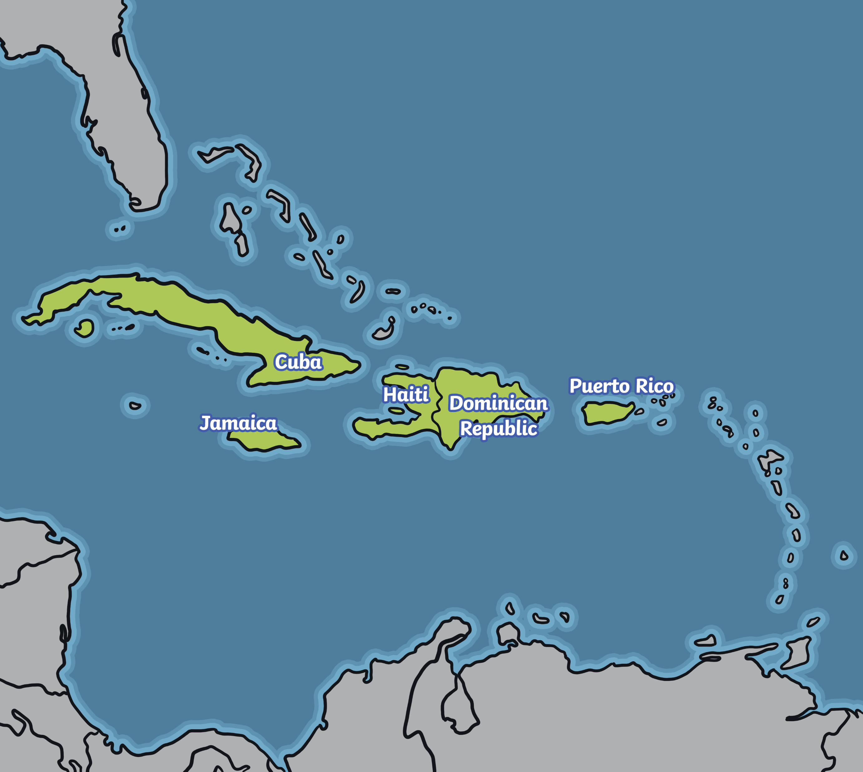
The Windrush Generation
The Caribbean is a group of tropical islands off the coast of Central America. Nowadays, many people travel to the Caribbean to go on luxury holidays.
As part of the British Commonwealth, children in these countries learnt English and were taught British history.
People living on islands, such as Jamaica, Trinidad and Tobago were offered the opportunity to start a new life in the United Kingdom.
windrushfoundation.com

Slide 5
The Windrush Generation
The first group of people to come from the Caribbean to Britain made a very long journey across the Atlantic Ocean on a ship called the Empire Windrush. It took about 22 days to make the crossing.
windrushfoundation.com

Slide 6
The Windrush Generation
On 22nd June 1948, the first 492 Caribbean people arrived at Tilbury Docks in Essex. They had left their homes behind and were embarking on a new life in a country thousands of miles away.
The passengers had many skills to offer. There were carpenters, mechanics, cleaners, nurses and steel workers. They soon found work in factories, on the railroads, driving buses and working in the newly formed NHS. Many of the passengers settled in the Brixton area of London, creating large Caribbean communities.
windrushfoundation.com

Slide 7
The Windrush Generation
The Caribbean people who sailed on the Empire Windrush, and those who followed, were told that they were welcome to come to Britain, the ‘mother country’.
Sadly, the reality of arriving in post-war Britain was very different for many immigrants.
Many of the Caribbean people were treated badly because of the colour of their skin or because they had been born in a different country. Some were refused work and could not find places to live. In some cases, shopkeepers refused to serve them. Many Caribbean people, including children, were called names in the street.
Discrimination and racism left many of the first Caribbean workers feeling afraid, angry, isolated and rejected.
windrushfoundation.com

Slide 8
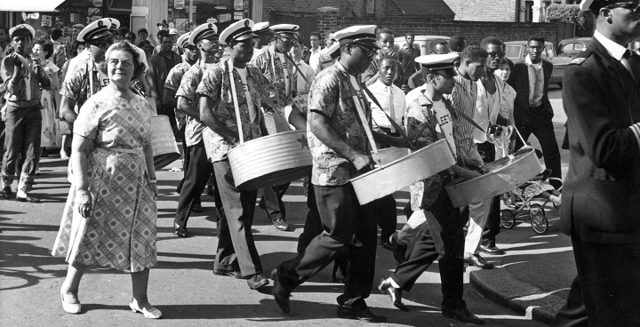
The Windrush Generation
The migration of Caribbean workers helped to make Britain a multicultural and a multiracial society. New languages, fashions, foods and ideas were introduced.
windrushfoundation.com

Slide 9
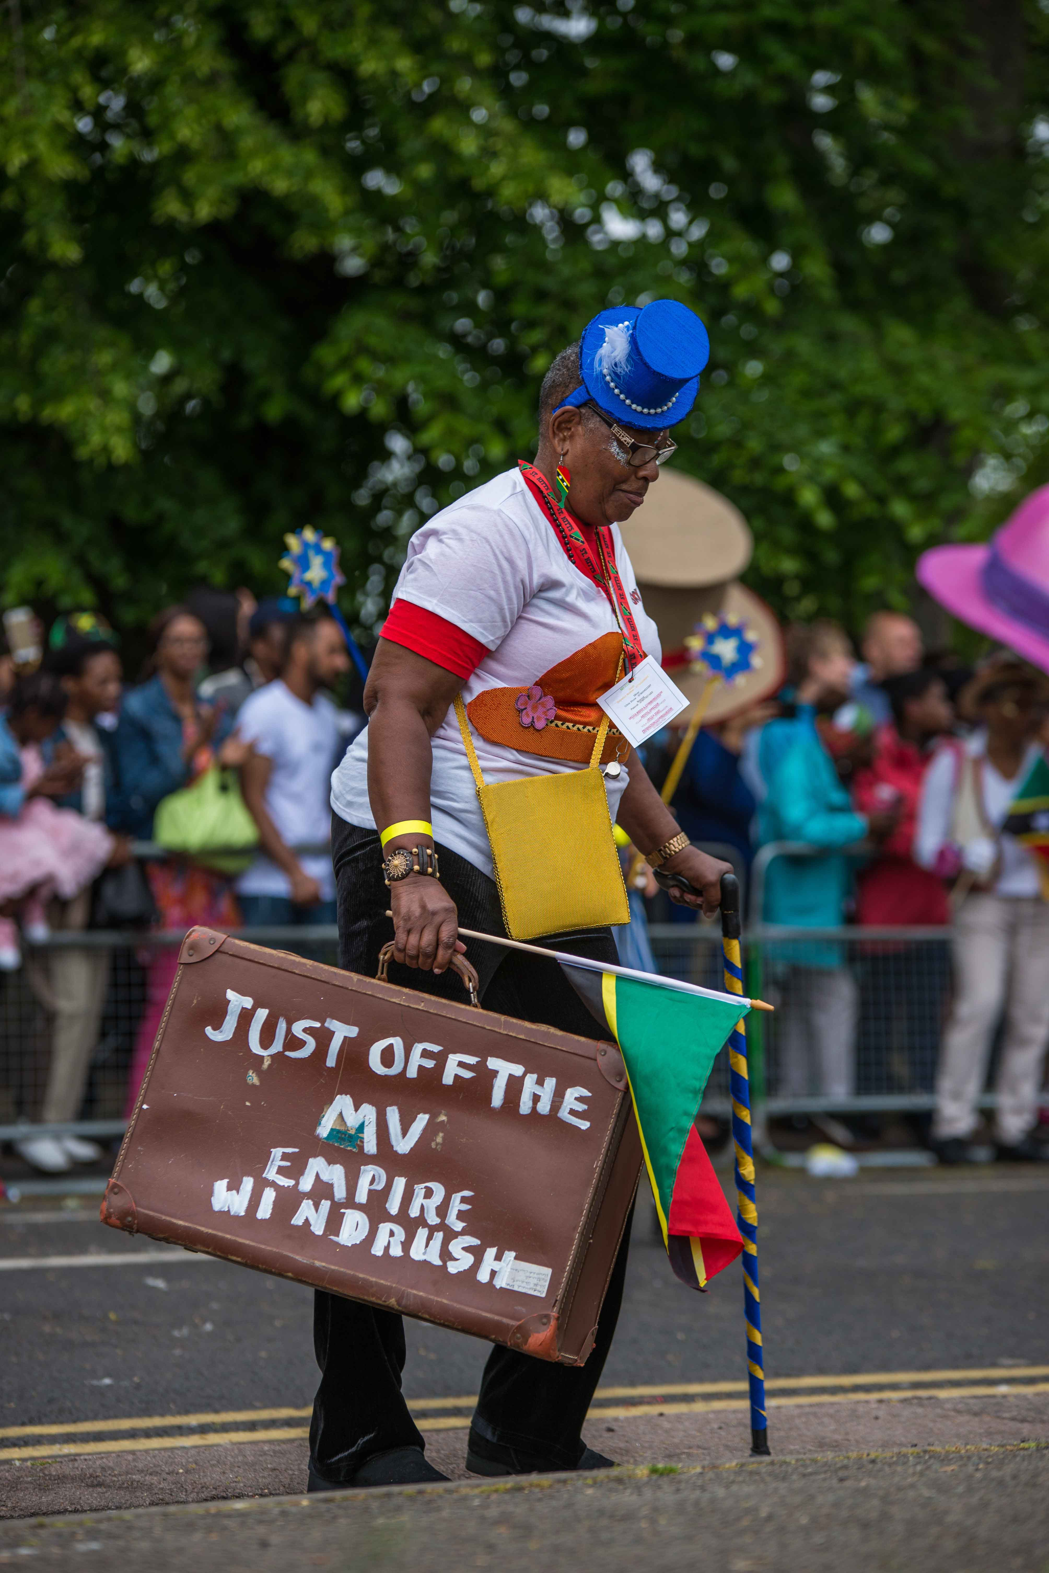
Luton Carnival Roots
One of the greatest things that the Caribbean workers brought with them was Carnival. Luton has hosted parades since the 1400s, but in 1976 the Windrush Generation introduced the Caribbean carnival flavour to Luton. The longest running Caribbean carnival groups in Luton is St Kitts, Nevis & Friends Carnival Group (SKNAF).
In 1984, the George Richards and other friends from St Kitts and Nevis came together to form St Kitts, Nevis and Friends Association (SKNAF). Activities of the Association grew into its involvement with the Luton International Carnival.
​
The group has been led for many years by Mrs Margaret Matthew (Auntie Margaret) here is a picture of Auntie Margaret at Luton International Carnival in 2018 with her Windrush suitcase.
St Kitts, Nevis and Friends carnival group continues to be an active participant in the Luton International Carnival.
St Kitts, Nevis & Friends Carnival Group, Luton International Carnival 2019

Slide 10
Luton Carnival Roots
Revellers Steelband took inspiration from the Empire Windrush ship to play a medley for Luton International Carnival judges in 2016. Their theme 'Luton is the Place for me’ was about migration to Luton from the Caribbean and beyond.
St Kitts, Nevis & Friends Carnival Group, Luton International Carnival 2019
Revellers Steelband classic calypso medley for Luton Carnival judges 2016 | Revellers Steelband

Slide 11
Luton Carnival Roots
Here is footage of Luton Independence Day Parade in 1964. Watch out for the Steelpan Band at the end, this might be the earliest glimpse of the Caribbean influence in Luton.
Luton Independence Day Parade, 1964 | Emerton321
St Kitts, Nevis & Friends Carnival Group, Luton International Carnival 2019

Slide 12
Luton Carnival Roots
Luton Carnival has grown into the biggest one day carnival in the UK.
Luton International Carnival | Copperwheat Films
St Kitts, Nevis & Friends Carnival Group, Luton International Carnival 2019

Slide 13
Luton Carnival Roots
What is different about parades in 1964 and today?
What has stayed the same?
St Kitts, Nevis & Friends Carnival Group, Luton International Carnival 2019

Slide 14
Carnival Costume Activity
How to make a Windrush headdress Mahogany Carnival Arts
https://www.mahoganycarnival.com/how-to-make-a-windrush-hat/
How to make a steelpan headdress with UKCCA
https://www.carnivalarts.org.uk/post/how-to-make-a-steel-pan-carnival-head-piece
We would love to share on our social media what you have made, your thoughts of Luton Carnival and any messages to our Windrush Generation in Luton.
Please share images, videos and comments via fiona@carnivalarts.org,uk

